Slide 1

Unit 1:- Electric and Hybrid Powertrain Technologies
By:- Dr. Chetan Khadse

Slide 2
Syllabus…Unit 1 Focus On….
Lecture | Topics to be covered
L1 | Introduction to vehicles, IC engine & Battery Electric Vehicles (BEV’s) , history and social importance
L2 | Benefits of E vehicles, Types of E-vehicles on the basis of propulsion devices, Energy sources and energy carriers.
L3 | PEV’s & HEV’s , BEV, HEV, FCEV, UCEV and UFEV
L4 | Classification of HEV, Micro hybrid, mild hybrid, full hybrid, plug-in hybrid and range extended hybrid electric vehicle.
L5 | Parallel hybrid, Series Hybrid, Power split and compound Hybrid Configuration Plug-in Hybrid Electric Vehicles (PHEV’s),
L6 | Hybrid Hydraulic vehicles (HHV),Pneumatic Hybrid Vehicles, (PHVs)
L7 | Power/Energy Management System

Slide 3
Lecture 3
EV Basic system
E-Vehicle Basic Block Diagram
Components of an EV….
Types of E- Vehicle?
EV’s Classification: Propulsion Devices
EV’s Classification: Energy Carrier
EV’s Classification: Energy Sources
Fuel Cells
Ultra Capacitors
Ultra Fly Wheel
HEV’s Basics
HEV’s Classification
HEV’s Conventional Hybrid & Grid-able HEV
Overall Classification of HEV

Slide 4
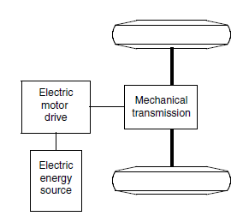
E-Vehicle Basic System ….
The EV was mainly converted from the existing ICEV.
It is done by replacing the internal combustion engine and fuel tank with an electric motor drive and battery pack while retaining all the other components
Drawbacks such as its heavy weight, lower flexibility, and performance degradation have caused the use of this type of EV to fade out

Slide 5
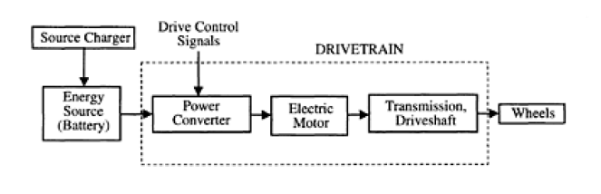
E-Vehicle Basic System ….
An EV has the following two features:
The energy source is portable and chemical or electromechanical in nature.
Traction effort is supplied only by an electric motor
The electromechanical energy conversion linkage system between the vehicle energy source and the wheels is the drivetrain of the vehicle. The drivetrain has electrical as well as mechanical components.

Slide 6
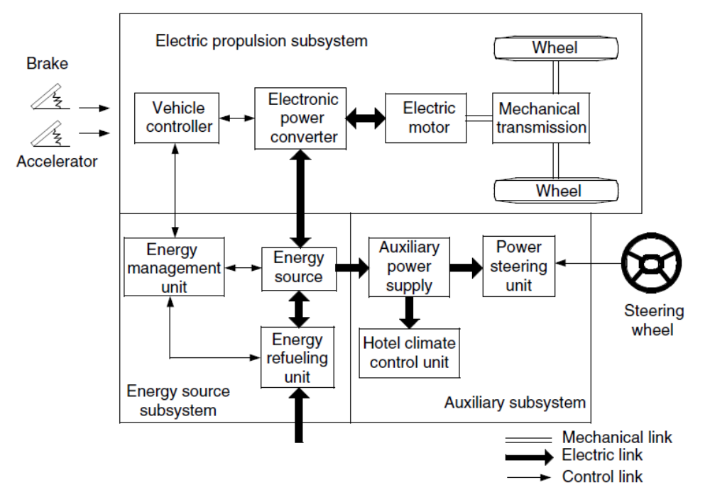
E-Vehicle Basic Block Diagram ….

Slide 7
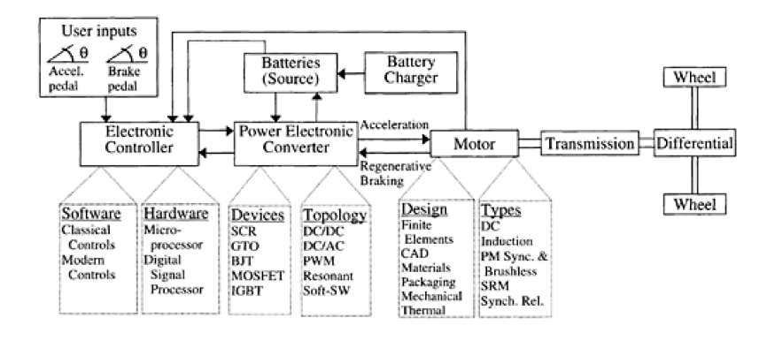
Components of an EV….
The primary components of an EV system are the motor, controller, power source, and transmission. The detailed structure of an EV system and the interaction among its various components are as shown in figure

Slide 8
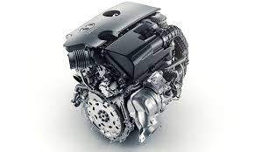
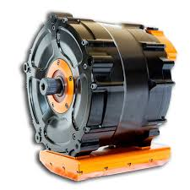
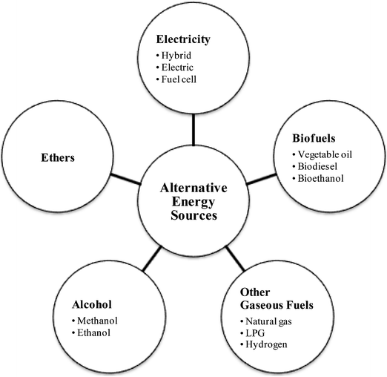
Types of E-Vehicles….
E- vehicles can be classified on the basis of
  Propulsion Devices
The propulsion system transfers the power to the wheels by a mechanical mechanism, IC Engine Or Electric Motor, or by a combination of both.
  Energy Sources
A vehicle that has two or more energy sources and energy converters is called a hybrid vehicle. EVs use chemical batteries, fuel cells, ultra capacitors, and/or flywheels for their corresponding energy sources.

Slide 9
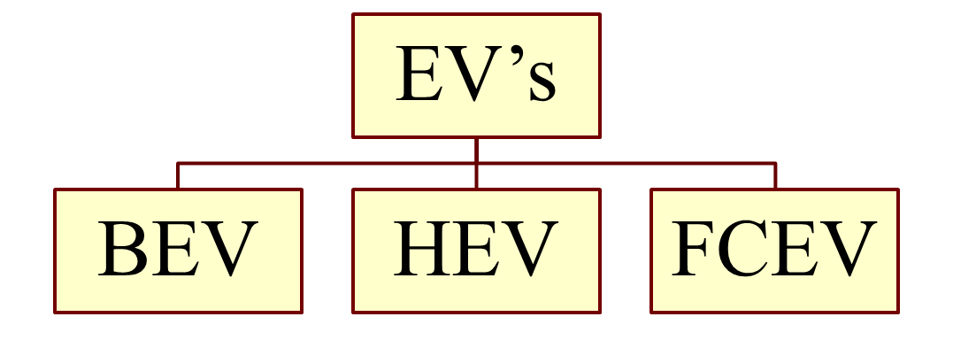
EV’s Classification: Propulsion Devices….
Based on Propulsion Devices, EV’s can be classified as
Pure Electric Vehicle (PEV)
As per energy source used also called Battery Electric Vehicle (BEV)
Hybrid Electric Vehicle (HEV)
Fuel Cell Electric Vehicle (FCEV)

Slide 10
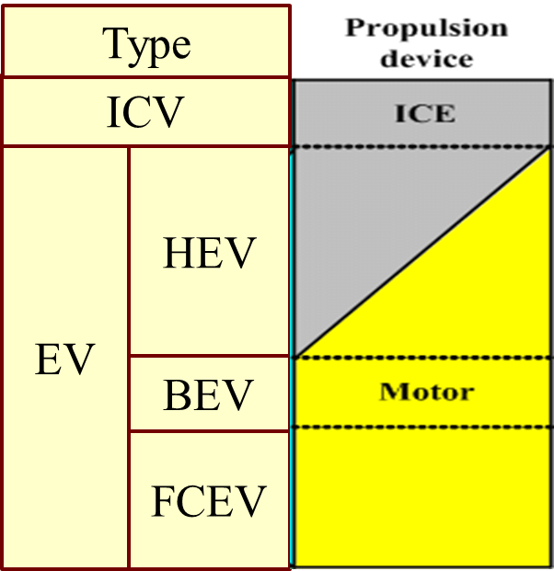
EV’s Classification: Propulsion Devices….
Based on Propulsion Devices, EV’s can be classified as
Pure Electric Vehicle (PEV)
As per energy source used also called Battery Electric Vehicle (BEV)
Hybrid Electric Vehicle (HEV)
Fuel Cell Electric Vehicle (FCEV)

Slide 11
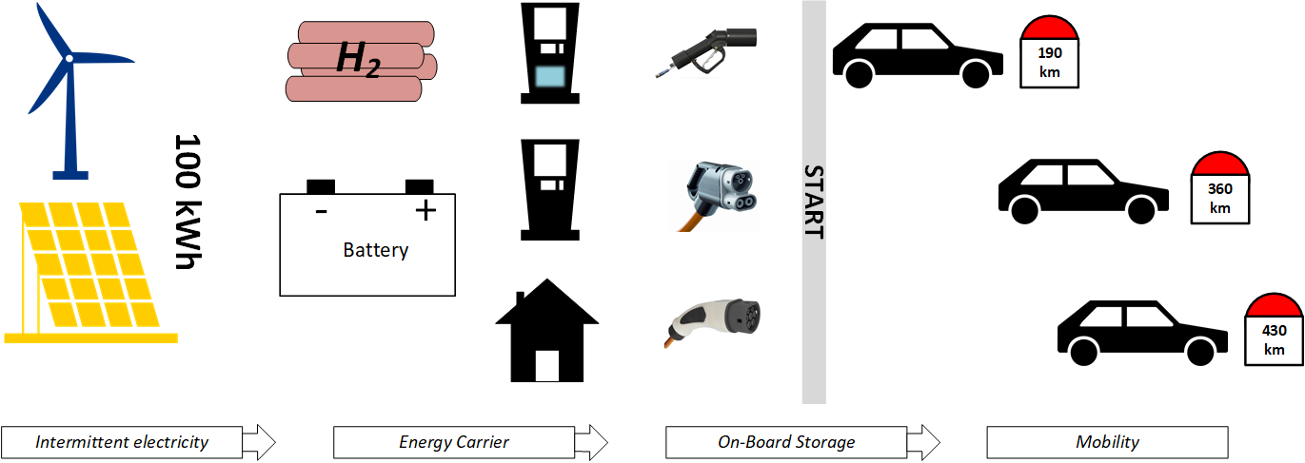
EV’s Classification: Energy Carrier….
E- vehicles can be classified on the basis of
  Energy Carriers
  If we classify The EVs on the basis of energy carriers, hybrid vehicle uses either Liquid Fuel or Electricity as energy carriers while a pure electric vehicle uses either Battery or Hydrogen as energy carriers.

Slide 12
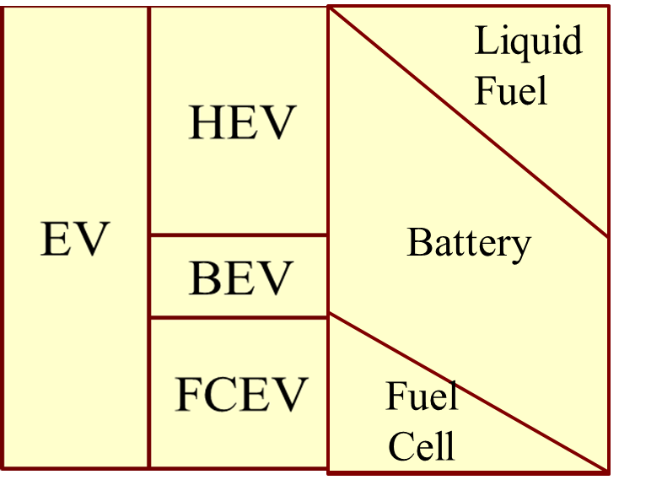
EV’s Classification: Energy Sources ….
  Based on Energy Sources, EV’s can be classified as
Hybrid Electric Vehicle (HEV), Battery Electric Vehicle (BEV) and Fuel Cell Electric Vehicle (FCEV)
Hybrid Electric Vehicle (HEV) uses both liquid fuel and battery as energy source
BEV uses only battery
FCV vehicle uses both battery and fuel cell

Slide 13
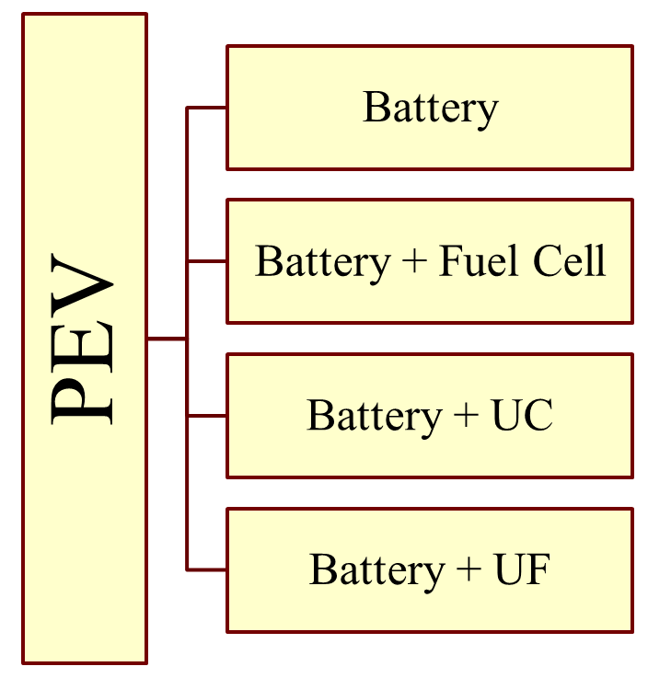
EV’s Classification: Energy Sources ….
  A similar classification can be done on the basis of energy carriers
  Energy carrier for battery is electricity
  Energy carrier for a fuel cell is Hydrogen.
  Energy carrier for Ultra-capacitors is stored Electric energy
  Energy carrier for Ultra-flywheel is stored Mechanical energy
  The battery is a common energy source

Slide 14
EV’s Classification: Energy Sources ….
  BEV uses battery as sole energy source,
  FCEV, UCEV and UFEV uses battery as a hybrid energy source.
  In a fuel cell electric vehicle, battery is primarily used for absorbing the regenerative power since fuel cell is incapable of storing the renewable energy.
  In ultra-capacitor and ultra-flywheel based EVs, batteries are required for storing energy since ultra-capacitor and ultra-flywheel have very low specific energy.
  As we Know Hybrid Electric Vehicle (HEV) uses both motor and IC engine for propulsion. On the basis of ratio of hybridization between electric motor and IC engine, it is classified in to further types.

Slide 15
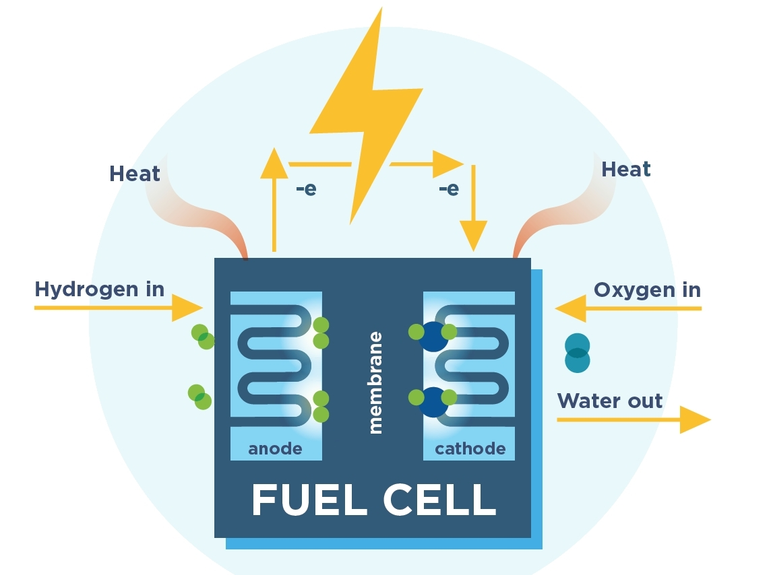
Fuel cell….
A fuel cell is a galvanic cell in which the chemical energy of a fuel is converted directly into electrical energy by means of electrochemical processes.
The fuel and oxidizing agents are continuously and separately supplied to the two electrodes of the cell, where they undergo a reaction.
Energy carrier for a fuel cell is Hydrogen.

Slide 16
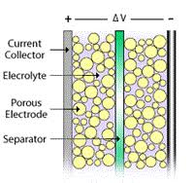
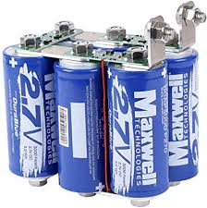
Ultra Capacitor….
The frequent start/stop operation of BEVs adversely affects the life cycle of batteries due to the high variation of the battery discharge profile.
They have significant difficulty providing sudden bursts of power for rapid acceleration and hill-climbing, due to their relatively low specific power density.
Ultra-capacitors are an energy (storage) source device with a high specific power density, high efficiency, and long cycle life, with the disadvantage of having low specific energy density.

Slide 17
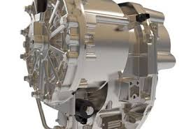
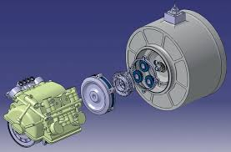
Ultra Flywheel….
Flywheels can achieve the potential energy storage requirements for EV applications. It can feasibly satisfy the requirements regarding high specific energy, high specific power, long cycle life, high energy efficiency, quick recharging, limited maintenance, and cost effectiveness.
Flywheels are used in a hybrid configuration (with the primary source in a BEV) as an auxiliary energy source, they function to store energy in a mechanical form.

Slide 18
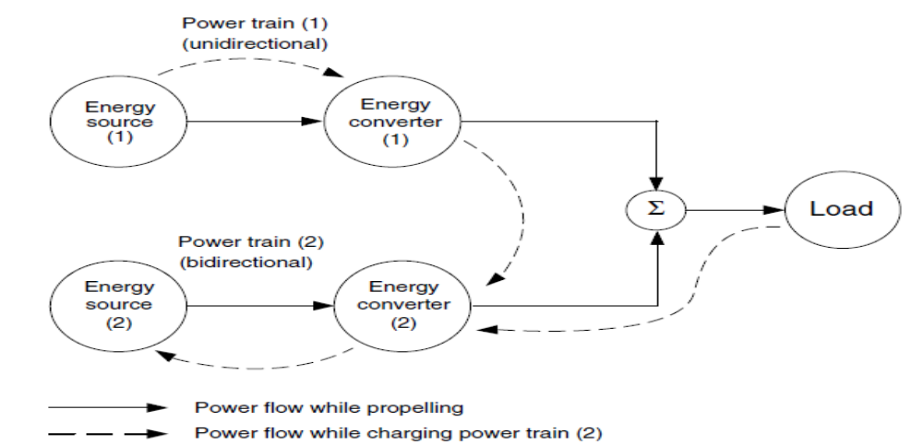
HEV’s Basics….
A vehicle that has two or more energy sources and energy converters is called a hybrid vehicle. A hybrid vehicle with an electrical power train (energy source energy converters) is called an HEV.

Slide 19
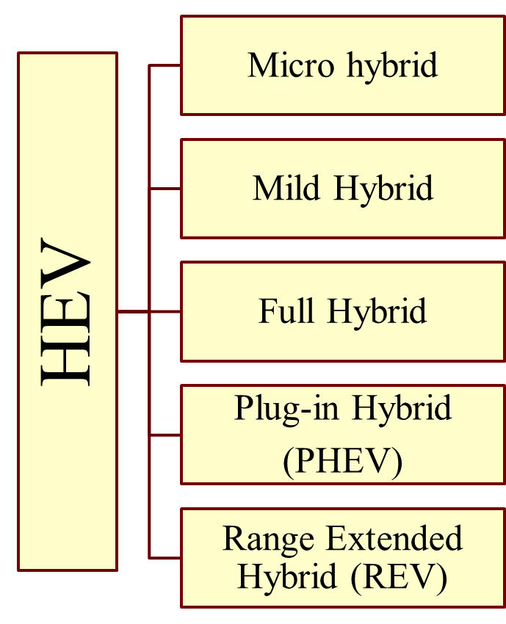
HEV’s Classification….
  The rating of electric motor is very low in micro hybrid vehicle and is high in REVs.
  On the other hand, the rating of IC engine is high in a micro hybrid while it is low in a REV
  Micro hybrid, Mild hybrid and Full hybrid are clubbed and known as Conventional Hybrid electric vehicle.
  Plug-in hybrid or PHEVs and range extended hybrid which is known as REV are clubbed under Grid-able HEVs.

Slide 20
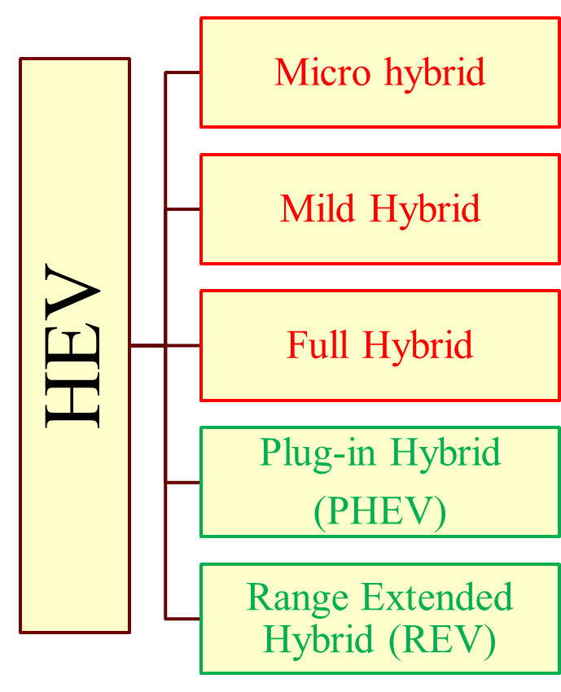
HEV’s Conventional Hybrid & Grid-able HEV….
  Conventional Hybrid electric vehicle can be refueled only at the filling stations or petrol pumps.
  Grid-able HEVs can be refueled both electrically and at the filling stations
  Grid-able HEV enables direct charging of battery using charging ports in addition to refueling by liquid fuels at a filling station.

Slide 21
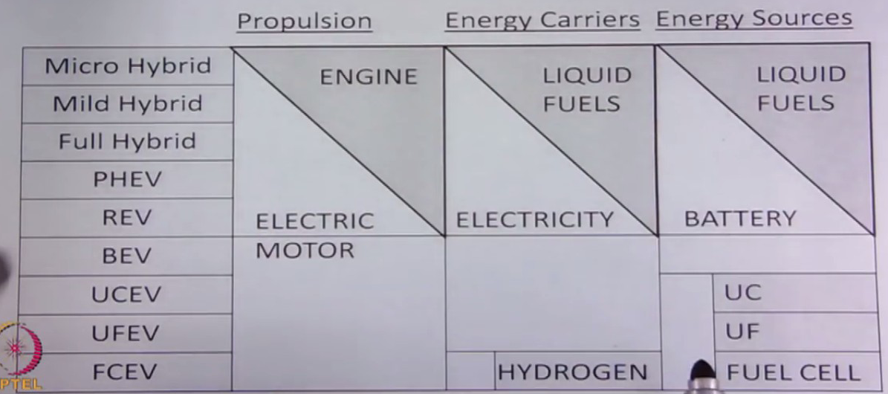
Overall Classification of HEV….
Source: NPTL Course

